Slide 1
Our agenda
What we are going to cover
Introduction
Our itinerary
What’s included
Our travel partner
Safety and support
Price and how to enroll
Notes:
SPEAKER:
[Intro]
First I’ll introduce myself and my background. I’ll also give you a quick intro to EF, our travel partner
[Our travel plans and tour itinerary]
Where we’re going and what we’ll be doing
[What’s included (and what’s not)]
The long list of items included in your tour
[Our Travel Partner]
EF is more than a travel partner; they support us in so many more ways which I will tell you about
[Safety & Support]
We’ll go over safety, EF’s top priority, and how EF supports us in the whole process from planning to traveling
[Price and Enrolling]
We’ll go over price and wrap up the meeting by opening enrollment and submitting your questions using the sign in form!
And with that, let’s dive in!

Slide 2
My name is
Notes:
SPEAKER:
[First just a little about me…]
I teach…
I’ve worked at the school for ___ years

Slide 3
EF Educational Tours
Our educational travel and safety partner
Notes:
Before we dive into the incredible itinerary we’ve selected for our trip, let’s talk about travel & safety partner, EF Educational Tours.
Over 55 years of experience
Staff on the ground in over 50 countries
EF always knows what is happening on the ground which is critical in an everchanging environment
They know how to safely navigate a city as true locals
They have an office close to us on tour in case we were to need extra support
World Leader in international education & accredited
EF is an accredited educational organization, just like our school. We’re going to have fun but also learn a lot too!
I feel extremely confident that partnering with EF is the best way to stay safe and healthy while having a life-changing experience. I’m going to go into more detail in a couple slides!

Slide 4
Northshore MS
Timbercrest MS
Bothell HS
Inglemoor HS
North Creek HS
Notes:
EF is the largest provider of educational student travel in the area
Many schools and teachers in our area already partner with them
Here are some examples of schools actively traveling with EF…

Slide 5
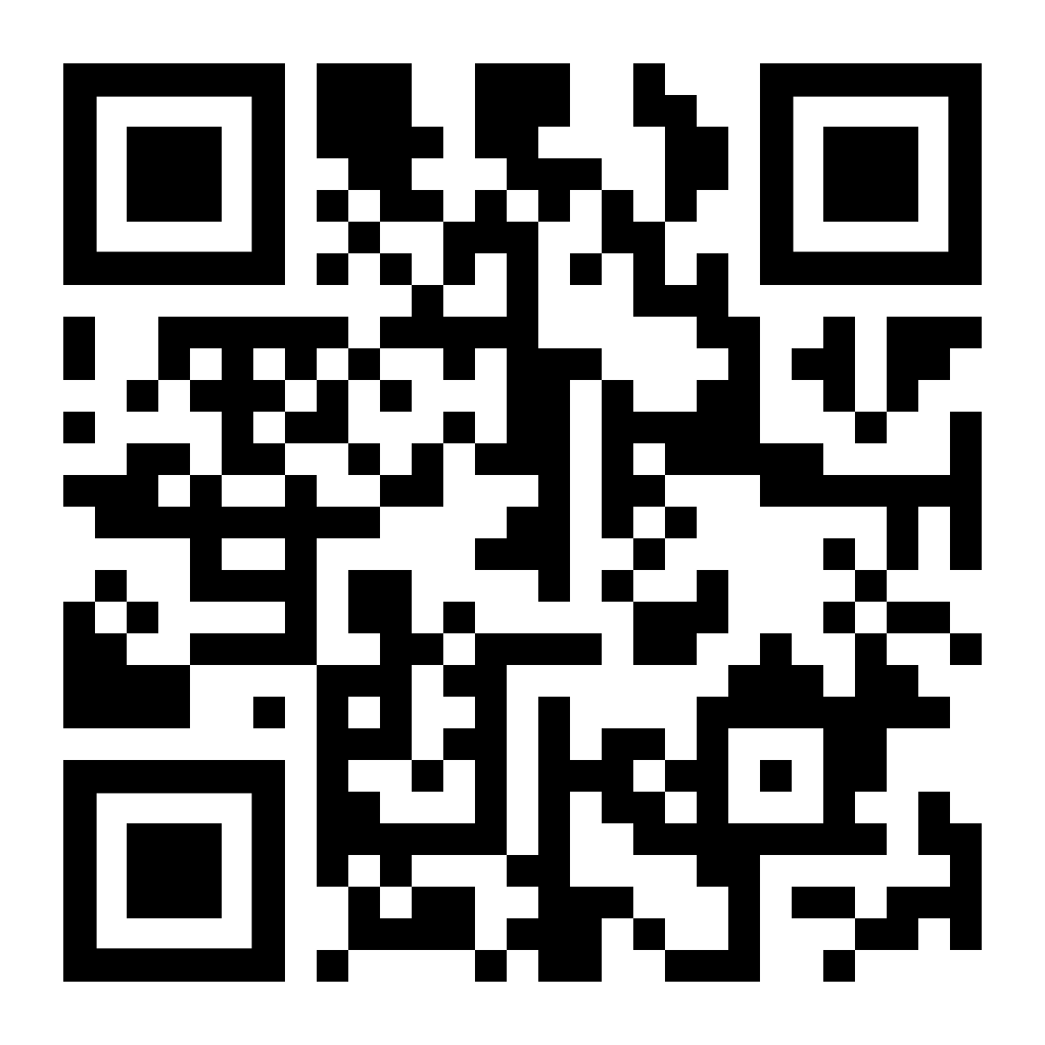
Let’s go to…
Italy & France
✈
Turin, Cuneo region, Langhe region, Liguria region, Nice, Monaco, Èze – 9 Days
Notes:
Welcome/ Thanks for coming to learn about this exciting opportunity for your child to travel abroad on an educational tour ____________ during _____________

Slide 6
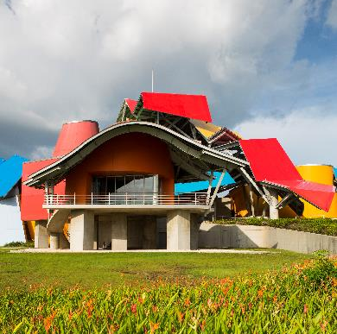
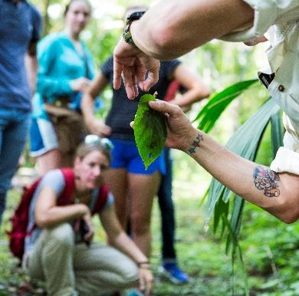
Our EF STEM experience
Experiential learning
We will apply STEM principles by participating in project-based learning that goes well
beyond theory
Innovative locations
We will tour exciting destinations that host some of the world’s most advanced laboratories, universities, and companies, or are simply perfect global “classrooms” to study scientific issues of the day in real life
Industry experts
We will collaborate and learn with scientists, engineers, researchers, and other STEM practitioners in the field

Slide 7
Sustainable Farming in Northern Italy

Slide 11
Take a stroll in Langhe region’s
famous grape vineyards

Slide 12
Learn traditional flour-making methods from
centuries ago in a 600-year-old watermill

Slide 13
Learn about sustainable farming practices
during a fruit orchard visit in Cuneo

Slide 14
Discover how food plays an integral role in the culture
during a cooking class with a local chef

Slide 15
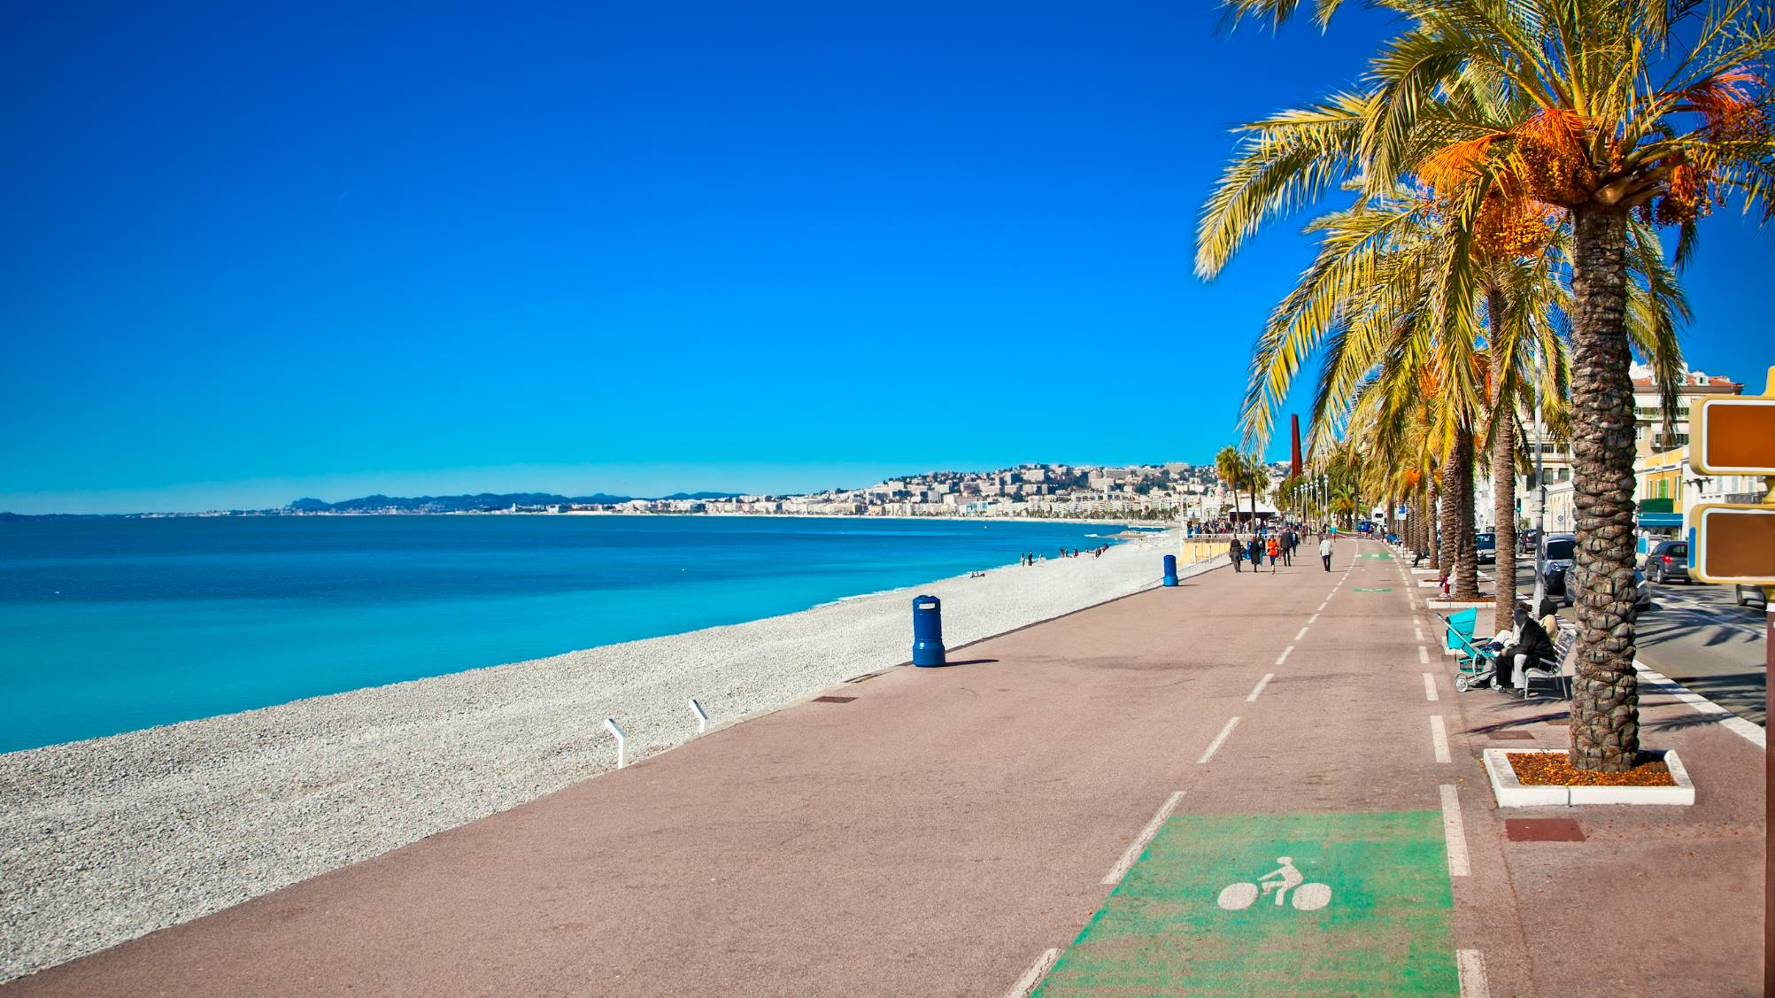
Walk down Nice’s iconic seaside
Promenade des Anglais

Slide 16
And don’t forget
about the food

Slide 17
Our Travel Dates
Notes:
Our Travel Dates
Because we are planning early, and because we want to get the best experience possible, we need some flexibility when it comes to travel dates. With that, we have a flexible travel window, which means we could be leaving as early as _____ and returning as late as______.
We will find out our exact dates 2-3 months before tour, but for now we could be traveling any time within that range.
Also to note, in the middle of that range falls ______(requested dates). You will see these dates as you enroll, but again, note that you could depart for your trip as early as _______ and return as late as _______.
We also have the chance of traveling with another school, which would be a great experience to meet other students!

Slide 18
What’s included in our itinerary
EF
Round-trip airfare on major airline carriers
Hotel stays at quality, clean accommodations
Regional-style meals for breakfast and dinner
Tour Director who will be with us 24/7
Transportation on tour, including a comfortable motorcoach bus
Expert local guides providing cultural insight
Guided sightseeing of all our destination has to offer
Hands-on STEM learning with industry-leading experts & organizations

Slide 19
Rooming
Students
Adults
Students are roomed 3-4 to a room based on gender marker listed on passports.
Adults are roomed 2 to a room based on gender marker listed on passports.
*If this doesn’t work for you, please let me know as soon as possible so we can talk through what other arrangements are available. Rooming upgrades are also available for an additional cost. (Please call Traveler Support to request an upgrade if needed)
Notes:
Overall, only adult rooming and any upgrades need to be communicated prior to tour.
In addition to me, if you have any detailed questions, the EF Traveler Support Team is also available to discuss rooming options with you if any student has specific needs (for example, medical or LGBTQ+ concerns).
Please note, for student rooming, where 3-4 students are roomed together, students should expect bed sharing.

Slide 20
Adults on tour
Chaperone
Adult Traveler
We’ll have an adult chaperone for every 6 travelers on tour.
Adults are welcome to join us! Just please know that these tours are for students and the pricing is different as a result for adults.
=
If you’re an adult or know an adult who would like to enroll, please read through the adult expectations guide I’ll send after our meeting.
Notes:
Overall, only adult rooming and any upgrades need to be communicated prior to tour.
In addition to me, if you have any detailed questions, the EF Traveler Support Team is also available to discuss rooming options with you if any student has specific needs (for example, medical or LGBTQ+ concerns).
Please note, for student rooming, where 3-4 students are roomed together, students should expect bed sharing.

Slide 21
What you are responsible for
Passports (and visas, if applicable) – apply now!
Tips for local guides, bus drivers and your Tour Director*
Snacks and some meals*
*We will discuss these costs with enrolled travelers prior to departure
Notes:
Not included
A few things. But no real surprises here.
As we get closer to departure I’ll hold a meeting for our enrolled travelers to talk through passports, tips, etc.

Slide 22
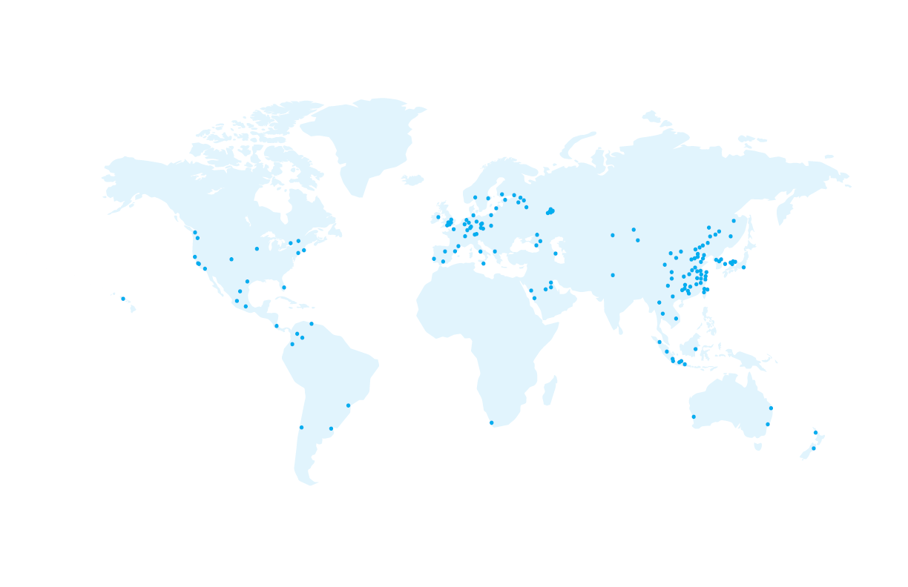
Why I partner with EF…
Notes:
EF is SO much more than just someone who books our flights and finds our hotels. Here are a couple reasons why I partner with EF………..

Slide 23
Our safety partner
Local support and insight worldwide
EF’s Safety and Incident Response Team
Rigorous health standards
24/7 Tour Director and chaperone team support
Notes:
Let’s talk about safety. I’ve done my research and feel incredibly confident partnering with EF.
EF has our back, they’ve thought of everything, and I trust their safety policies
They have multiple programs in place to help keep us safe
EF will be right there to support us (locally, globally, pre-tour and on-tour) to help us through any situations that arise
Bottom line: we are safer traveling with EF than we ever would be on our own.
They have policies to protect our investment pre-tour (which will cover in a minute), but they also provide us with a lot on tour:
Local support and Insight
As you have already seen, EF is a global company! Because of this, EF has local knowledge to keep our groups safe no matter where we are in the world.
Safety & Incident Response Team
• EF’s has a team of experts located around the world, their #1 priority is safety
• They are always ready to respond to ensure that a train strike or a sprained ankle won’t slow us down
Their emergency support team is available 24/7, 365 days a year
Rigorous health standards
EF has enhanced safety precautions and procedures that cover everything from cleanliness to adjusting tours as needed.
24/7 Tour Director and chaperone team support
• In traveling with EF, there is a support team, from our Tour Director to myself, to my chaperones

Slide 24
Our education partner
The best way to help students gain new perspectives and build skills for the future is through experiential learning
EF’s Personalized Learning Guide
Students can earn 0.5 high school credits (included) by using this guide. This guide puts a more personal lens on their tour by tapping into their own interests and passions.
College Credit
Students can earn 3 college credits by taking a 16-week, tuition-based, course related to their tour experience
post-tour.
College essay
help
EF’s college essay guide helps students use their tour as inspiration for a personal essay that admissions officers can’t resist.
www.eftours.com/credit
Notes:
To take it to the next level there are three ways to continue personal and educational growth:
Personal Learning Guide
This guide helps students put a personal lens on their travel experience by having them view their trip through their own interests & passions
By completing this option, students will receive 0.5 high school credits
This option is FREE: EF is accredited just like our school
College Credit
Students have the option of earning 3 college credits through a course from Southern New Hampshire University
You can add this college class when you enroll for tour
College essay help
This is designed to help students take their personal experiential learning experience on tour as inspiration for their personal college essay
***Registration for both high school and college credit options needs to happen prior to tour. This can be right when you enroll, or after you enroll**

Slide 25
Book with confidence
Notes:
EF is offering a few things to help us protect our investment, to give us the confidence to book our travel experience now, while monthly payments are so affordable. Here are some of the ways that EF is protecting our investment:
Peace of Mind
EF’s Peace of Mind Program gives our group the flexibility to modify our tour or dates if we’re uncomfortable traveling as we get closer to departure.
Global Travel Protection*
Custom-designed travel protection unique to EF, provides both pre-tour and on-tour benefits.
Global Travel Protection Plus is available to you the day you enroll as well
Risk-Free Enrollment
If travelers enroll by [X Date] they will qualify for EF’s risk-free enrollment period
I hope these programs help give you all comfort and confidence to enroll on this experience now. If you want more information on ANY of these programs, I'll be sending out all the details after this session.

Slide 26
Making it happen
Global Citizen Scholarship
This scholarship is designed to help students discover the world—and their place in it.
EF awards up to $100,000 in scholarships each year
Needs- and merit-based
Any enrolled traveler may apply
Customizable Tour Fundraising Page
Every traveler who enrolls will receive an individual tour fundraising page.
Anyone can contribute! Send your fundraising page to friends, family, and loved ones
100% of all contributions made will go directly toward your tour balance
*Our due date is February 13, 2025
Notes:
EF offers a few additional opportunities to help fund our travel as well.
Global Citizen Scholarship
$1,000 needs & merit-based scholarship
To be eligible, complete application and submit a 2-3 minute video on how will this tour change the way you think, feel, or act about the world?
All students traveling before are eligible to apply for the Global Citizen Scholarship. Find out more specific information online at eftours.com/global-citizen
Personal Tour Fundraising Page
Once you enroll, you can send out your personal tour Fundraising URL from your traveler page.
This page works just like a “Go Fund Me page” but better because you see 100% of the contributions applied to your tour balance
Great for holiday/birthday gifts, payment for baby sitting/mowing lawns, or just sending to friends/family who want to help you see the world!

Slide 27
Itinerary & logistics
Payments & protection
Safety & support
Personalized learning
Everything we talked about getting on tour!
Flexible payment options
Personal Tour Fundraising Page
Global Travel Protection Plan
Personal traveler account online
Traveler Support Team
24/7 Safety & Incident Response Team
Peace of Mind Program
Project-based learning guide
High school and college credit options available
College essay help
Included
Notes:
Like I said, we get SO much more by traveling with EF beyond our itinerary and logistics, we have options for payments and protection, amazing safety and support, and personalized learning opportunities for everyone

Slide 28
This is a non-school sponsored trip
Notes:
And finally, here is why we’re planning so far in advance. EF offers a variety of ways to pay for this experience. The easiest and most common ways to pay are the bi-weekly and monthly payment options, which allow you to budget for your tour just like any monthly expense.
Bi weekly
Bi-weekly payments are (X dollars) after the initial $95 dollar fee
Monthly
The most popular way to pay with EF is on a monthly basis, and if you enroll by our deadline, the monthly payments are (X dollars) a month.
Pay in full
For those who want to pay in full you can do that too
Adults can travel too
Same easy options. The price is a bit different because of rooming.
Discount
And another reason I’m planning right now, is that if you enroll by my deadline – you will get a discount off this price.
Manual Payment Plan
If you need more options, you can also select EF’s manual payment plan which follows a set invoicing schedule. Just give EF’s Traveler Support team a call and they can help. This plan does require some additional fees paid upfront – a $50 fee to enroll in this plan - in addition to the $95 fee. This plan is not valid for EF’s Risk-free enrollment period.

Slide 29
Spots Available!
Secure your spot with a $95 enrollment fee.
4/12/24
50+
15
April 12th
Notes:
I can’t wait to experience this trip with all of you. At this point, enrollment is officially open!
There are so many people interested in this experience
I anticipate that this trip will be very busy
Please keep that in mind, if this is something you are interested in doing, I would do it right away
So you can grab one of those spots before they’re gone
Guaranteed Spots available
I have (X) spots available on this trip
To earn discount, enroll by…
And if you enroll by (deadline) you’ll receive a $200 discount on the cost of your tour & qualify for EF’s risk-free enrollment period.

